Slide 1
Treatment of Blood Cholesterol to Reduce Atherosclerotic Cardiovascular Risk in Adults
2013 ACC/AHA Guideline on

Slide 2
Overview
RCTs indicated a constant reduction of ASCVD by statins in 1ry & 2ry prevention.
No event reduction with statins in
NYHA class II to IV Heart Failure
Haemodialysis
These trials not designed to evaluate the effect of titrated statin tx to achieve specific LDL-C/Non HDL-C levels.
Expert panel found evidence that use of additional therapy to lower Non HDL-C once LDL target was achieved did not further reduce ASCVD outcomes.
Extensive RCT evidence that appropriate intensity of statin therapy should be used to reduce the ASCVD in those most likely to benefit.

Slide 3
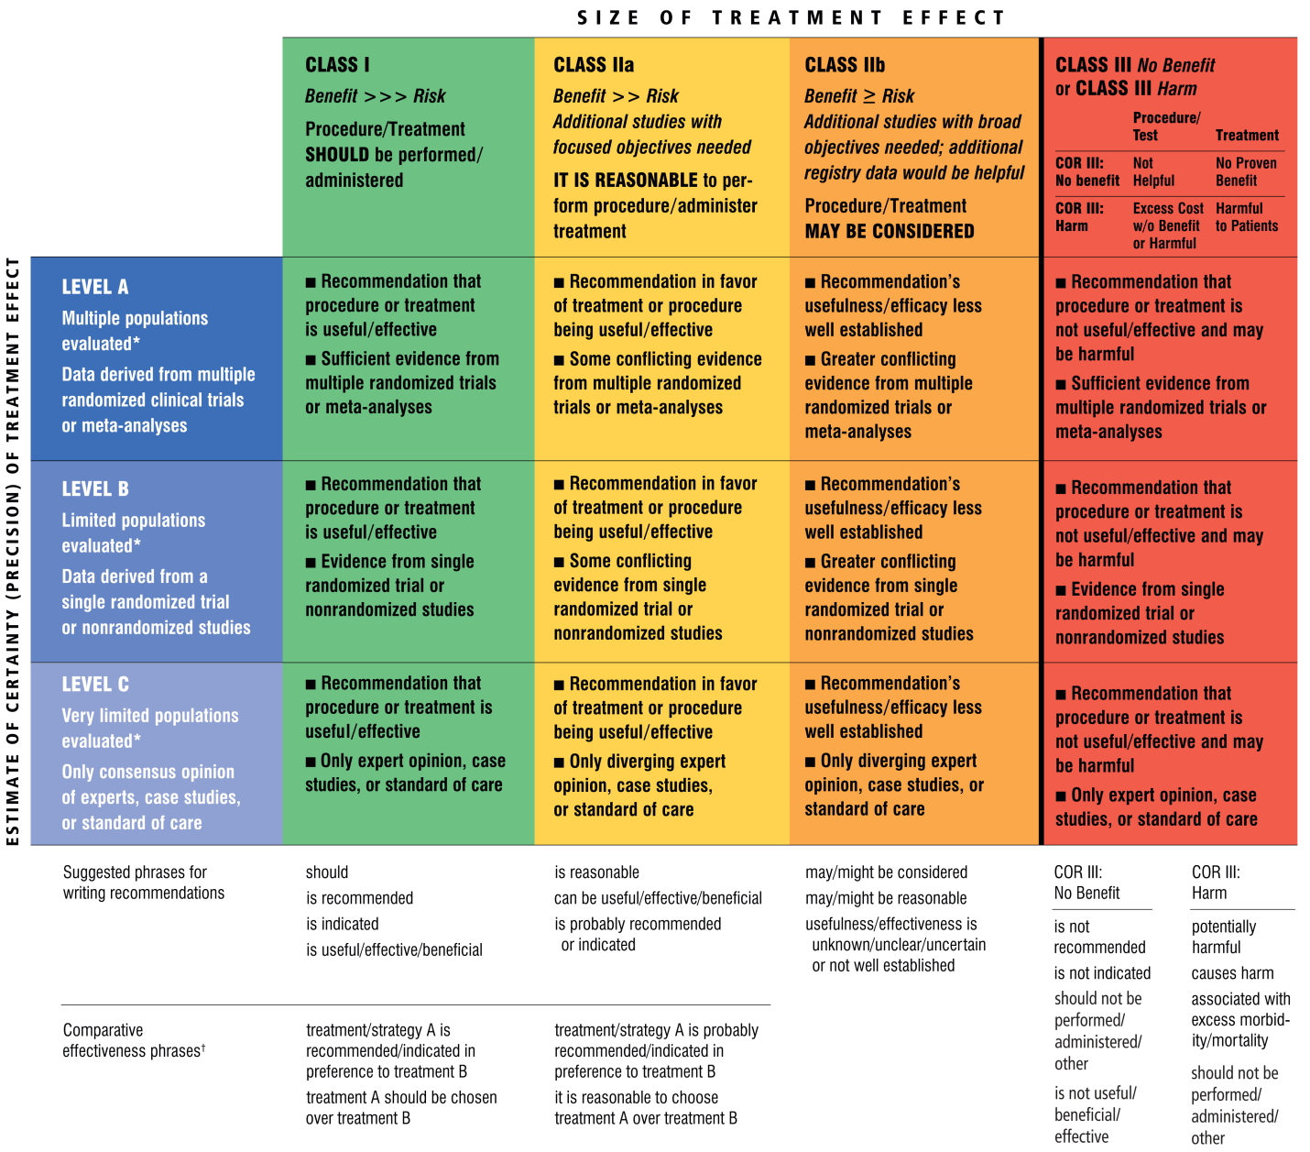

Slide 4
Life style
Foundation for ASCVD risk reduction efforts.
Adapted both prior to and in concert with the use of cholesterol lowering agents
Adhering to a healthy diet.
Regular exercise habits.
Avoidance of tobacco products.
Maintenance of healthy body weight.

Slide 5
Major Statin benefit groups
Individuals with clinical ASCVD
Individuals with primary elevation of LDL-C ≥190 mg/dL
Diabetes aged 40-75 yrs with LDL-C 70-189 mg/dL & without clinical ASCVD
Individuals without clinical ASCVD/diabetes with LDL-C 70 -189 mg/dL & estimated 10 year ASCVD risk ≥ 7.5%

Slide 6
Major Statin benefit groups
ASCVD risk reduction clearly outweighs the risk of adverse events.
Absolute risk reduction of ASCVD events is proportional to the baseline absolute ASCVD risk.
Extensive and consistent RCT evidences support the benefit of statins for prevention of ASCVD in these 4 groups

Slide 7
Clinical ASCVD
Acute Coronary syndrome.
Hx of Myocardial Infarction & Unstable / Stable angina.
Stroke / Transient Ischaemic Attack.
Peripheral Vascular Disease.
Coronary/other arterial revascularization.

Slide 8
Intensity of Statin Therapy
On the basis of average expected LDL-C response to specific statin and dose
High Intensity Statin - Lowers LDL-C by ≥50%
Moderate Intensity Statin – Lowers LDL-C by 30% - <50%
Low Intensity Statin – Lowers LDL-C by <30%

Slide 9
Intensity of Statin Therapy
Evidences suggest that relative reduction in ASCVD risk is related to the degree by which LDL-C is lowered.
There is no differentiation between specific statins & doses used in primary and secondary prevention.

Slide 10
Intensity of Statin Therapy
High Intensity Statins | Moderate Intensity Statins | Low Intensity Statins
Atorvastatin 40-80 mg | Atorvastatin 10-20 mg | Provastatin 10-20mg
Rosuvastatin 20-40 mg | Rosuvastatin 5-10 mg | Lovastatin 20 mg
 | Simvastatin 20-40 mg
 | Provastatin 40-80 mg
 | Lovastatin 40 mg

Slide 11
Major Recommendation of Statin Therapy for ASCVD Prevention

Slide 13
1. Patients with clinical ASCVDs (Secondary Prevention)

Slide 14
In patients <75yr old with ASCVDs
High intensity statin should be initiated. or
Intensity should be increased to high intensity.
Level A Evidence with Class 1 recommendation
If high intensity statin therapy is contraindicated / statin associated adverse events are present
Moderate intensity statin therapy should be considered.
Level A Evidence with Class 1 Recommendation

Slide 15
In Individuals > 75y with clinical ASCVDs
Moderate intensity statin should be considered.
Statin therapy should be individualized
ASCVD reduction benefit
Potential adverse effects
Drug to drug interactions
Reasonable to continue if they are tolerating (high intensity) statin therapy
Level B Evidence with Class 2A Recommendation

Slide 16
2. LDL-C ≥ 190mg/dL (Primary Prevention)

Slide 17
Adults ≥21 Y with primary elevation of LDL ≥190mg/dL
Life time risk of ASCVD due to exposure markedly elevated LDL-C.
Should receive statin therapy for substantial reduction in LDL-C.
High Intensity Statin therapy is recommended
(To Achieve at least 50% reduction in LDL-C)
Moderate Intensity statin therapy if high intensity statins are not tolerated/adverse events are present.
Level B Evidence with Class 1 Recommendation

Slide 18
Maximal statin therapy might not be adequate to lowering LDL-C to reduce ASCVD events.
Often Non Statin Cholesterol lowering agents are needed to lower LDL-C.
Family screening necessary to identify other family members.
Secondary causes may contribute severe elevations of LDL≥190mg/dL & TG≥500mg/dL
Should be evaluated and treated properly.

Slide 19
Secondary Causes | ↑ LDL-Cholesterol | ↑ Triglycerides
Diet | Saturated/Trans fat Weight gain | Refined Carbohydrates Alcohol intake Weight gain
Drugs | Glucocorticoids | Glucocorticoids Oral Oestrogens
Diseases | Bile duct obstruction Nephrotic syndrome | Chronic Renal Failure Nephrotic syndrome
Disorders/Altered state of metabolism | Hypothyroidism Obesity | Hypothyroidism Obesity Diabetes

Slide 20
3. Diabetic patients aged 40-75yrs without ASCVD with LDL-C 70-189mg/dL (Primary Prevention)

Slide 21
Diabetic patients aged 40-75yrs without ASCVD with LDL-C 70-189mg/dL
Moderate intensity statin therapy is recommended.
Level A Evidence with Class 1 recommendation.
High intensity statin therapy is recommended for individuals with DM with ≥ 7.5% estimated ASCVD risk.
Level B Evidence with Class 2A recommendation.
In patients <40y & >75y with DM, statin therapy should be individualized (Expert Opinion)

Slide 22
4. Patients with LDL 70-189mg/dL without clinical ASCVD/Diabetes (Primary Prevention)

Slide 23
Patients aged 40-75y with LDL 70-189 mg/dL without clinical ASCVD/Diabetes
Depends on estimated 10 year ASCVD risk.
ASCVD risk reduction benefit from Moderate / High intensity statin therapy in individuals with ≥7.5% of ASCVD risk.
ASCVD risk reduction clearly outweighs the potential adverse effects.
Level A Evidence with Class I Recommendation.
Moderate Intensity statin therapy is recommended in individuals with 5-7.5% of ASCVD risk.

Slide 24
No data on primary prevention available for Individuals aged 21 – 39 years.
Few data on primary prevention were available for individuals >75 years.

Slide 25
Global risk assessment for primary prevention
Pooled cohort equation is used to estimate the 10 y ASCVD risk in both men/women and black/white.
Accurately identify higher risk group for statin
Statin therapy should be patient centered in primary prevention.
(ASCVD risk reduction benefit, adverse effects, drug-drug interaction and patient preferences should be considered.)
Patients >70 yr without other risk factors will receive statin on the basis of age alone.
Most ASCVD occur > 70 yr
Giving Statin to individual > 70 y – Greatest potential for risk reduction

Slide 26
Pooled cohort equations
Developed by risk assessment workgroup.
Predicts 10 year ASCVD risk defined as
First occurrence of non fatal/fatal Myocardial infarction/stroke respectively.
This equation used to predict ASCVD risk in individuals with/without diabetes with LDL 70-189mg/dL

Slide 27
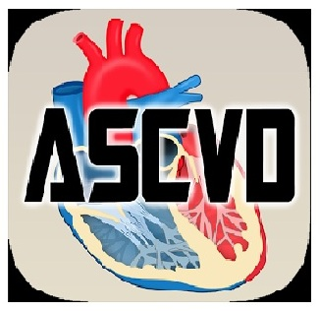
Since most of us are smart phone users!!
Mobile applications of pooled cohort equations are available for Android/IOS

Slide 28
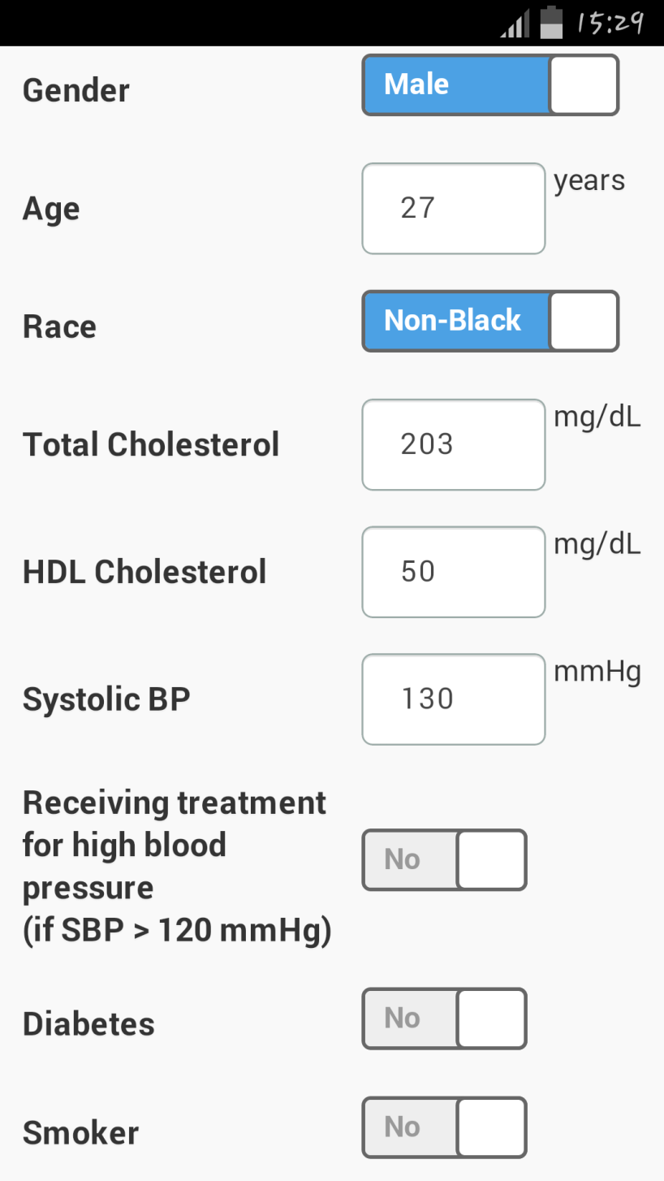

Slide 29
In Adults with LDL<190 mg/dL who are not otherwise identified in statin benefit group
After a quantitative risk assessment, a risk based treatment decision is uncertain.
Initiation of Statin therapy should depends on
Clinicians’ knowledge
Experience and skills
Patient preferences
Other risk factors

Slide 30
Other Risk factors
Primary LDL-C >160mg/dL
Other evidences of genetic hyperlipidaemias.
FHx of Premature ASCVD with onset
Less than 55y in 1st degree male relative
Less than 65y in 1st degree female relative.
High sensitivity CRP ≥ 2 mg/L
Coronary artery calcium score ≥ 300 Agaston units
Ankle brachial index<0.9
Elevated life time risk for ASCVD.

Slide 31
Finding support that use of Statins:
Prevent both non fatal and fatal ASCVD events.
Reduce burden of disability from non fatal stroke (W>M) and non fatal CHD
Primary prevention and secondary prevention of ASCVD can positively impact on risk of health care cost.
High level of evidence suggest reduction of total mortality in individuals with history of prior ASCVD (IIry prevention)
Moderate evidence suggest reduction of total mortality in Primary prevention set up

Slide 32
Few trials have been performed with non statin cholesterol lowering drugs in statin era.
Unable to demonstrate significant additional ASCVD event reduction.
Less evidence to the support the use of non statin drugs for ASCVD prevention

Slide 33
Past Approaches to treatment of blood Cholesterol
Target to treat – Most widely used in last 15 years.
Current clinical data don’t indicate what the target is.
Don’t know the magnitude of additional ASCVD risk reduction with one target lower than the other
Potential adverse effects of multi drug therapy.
Lowest is the best.
Treat the level of ASCVD risk.
Used currently to determine the 4 statin benefit group based on extensive body of RCT evidence.
Lifetime ASCVD risk.
Problematic
Lack of data on long term follow up, safety and ASCVD risk reduction when statins are used >10years and treatment of individuals < 40 years.

Slide 34
A New Perspective on LDL-C & Non HDL-C goals
Many clinicians use targets as
 | LDL Cholesterol | Non HDL Cholesterol
Secondary Prevention | < 70 mg/dL | < 100 mg/dL
Primary Prevention | < 100 mg/dL | < 130 mg/dL

Slide 35
However
ASCVD events are reduced using max tolerated statin intensity
No RCT evidence of titrated drug therapy to specific LDL/Non HDL-C goals to improve ASCVD outcomes
Use of LDL-C targets
May result in under treatment with evidence based statin therapy
May result in over treatment with non statin drugs which have no benefit in ASCVD event reduction.

Slide 36
Safety of Statin therapy
Selection of statin and dose should be based on
Patient characteristics.
Level of ASCVD risk.
Potential for adverse effects.
Moderate Intensity Statin therapy should be used in individuals in whom High-Intensity Statin therapy would otherwise be recommended when characteristics predisposing them to statin associated adverse effects are present
Level B Evidence with Class 1 Recommendation

Slide 37
Characteristics predisposing individuals to statin adverse effects
Multiple or serious Co- morbidities, including impaired renal or hepatic function.
History of previous statin intolerance or muscle disorders.
Unexplained ALT elevations >3 times ULN.
Patient characteristics or concomitant use of drugs affecting statin metabolism.
>75 years of age.
History of hemorrhagic stroke.
Asian ancestry.

Slide 38
Creatine Kinase Levels
Routine measurement of creatine kinase in individuals receiving statin is not recommended.
Level A Evidence with Class 3 Recommendation.
Measurement should be reserved for those with muscle symptoms.
Measurement of a baseline creatine kinase may be useful in those with increased risk for adverse muscle events.
Personal or family history of statin intolerance or muscle disease
Clinical presentation likelihood of myopathy
Concomitant drug therapy might increase the likelihood of myopathy

Slide 39
Management of Muscle symptoms Level C Evidence with Class 2B Recommnendation
Symptoms: Pain, tenderness, stiffness, cramping, weakness, or fatigue
History of prior or current muscle symptoms to establish a baseline before initiating statin therapy
If unexplained severe muscle symptoms or fatigue develop
Discontinue the statin
Address the possibility of Rhabdomyolysis by evaluating CK, creatinine, and a urinalysis for myoglobinuria.
If mild to moderate muscle symptoms develop .
Discontinue the statin until the symptoms can be evaluated
Exclude other conditions that might increase the risk for muscle symptoms
If muscle symptoms resolve , give original or a lower dose of the same statin to establish a causal relationship
If a causal relationship exists, discontinue the original statin
Once muscle symptoms resolve, use a low dose of a different statin and gradually increase.

Slide 40
ALT Levels
Baseline measurement of transaminase (ALT) levels should be performed before initiating statin therapy.
No recommendation to monitor transaminase (ALT) levels. (No difference noted between treatment group and control)
During Statin therapy, it is reasonable to measure hepatic function if symptoms suggesting hepatotoxicity arise
Unusual fatigue or weakness,
Loss of appetite
Abdominal pain
Dark-colored urine
Yellowing of the skin or sclera

Slide 41
Type 2 Diabetes Mellitus
Statins modestly increase the excess risk of type-2 diabetes in individuals with risk factors for diabetes.
The potential for an ASCVD risk reduction benefit outweighs the excess risk of diabetes in all
All individuals receiving statins should be counseled on healthy lifestyle habits
Individuals receiving statin therapy should be evaluated for new-onset diabetes according to the current diabetes screening guidelines

Slide 42
Decreasing the statin dose may be considered when 2 consecutive values of LDL–C are <40 mg/dL.
This recommendation was based on the approach taken in 2 RCTs.
Level C Evidence with Class 2B recommendation
However, no data was identified that suggests an excess of adverse events occurred when LDL–C levels were below this level.

Slide 43
Monitoring Statin Therapy

Slide 45
Thank you

