Slide 1
A STUDY TO DESCRIBE PERCEPTION REGARDING THE NATIVE LANGUAGE TRAINING PROGRAMME PRIOR TO INTERNSHIP AMONG THE MEDICAL OFFICERS
Padeniya PSMAB¹, Colambage SP², Epitakaduwa C³, Ranasinghe JMSD⁴, Ananda SKA⁵, Tennakone ADTMSS⁶, Kannangara SU⁴, Aluthge HP⁴,Dharmaratne CS⁴, Bulankulame SWKMB⁷Herath HMNP⁸, Soysa HND⁹Fernando SJ^{4,}Wijesooriya WIN⁴, Thangaraja G⁴,DevapriyaKD¹³,Lathaharan A¹², Ariyarathne N⁴,Sagara DCRR⁴, Gamage CET⁴

Slide 2
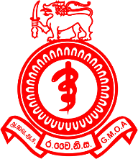
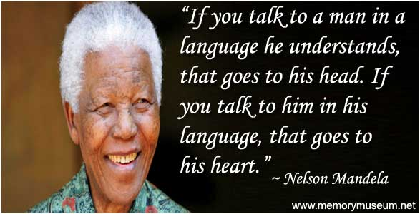
Introduction
Sri Lanka is a multi-lingual country.
Most of the first on-call doctors are Intern House officers
70% of the medical diagnosis is based on History
Quote from Nelson Mandela

Slide 3
If you talk to a man in his own language, it goes to his heart.
Doctors should talk to patients’ heart
It is essential that the intern medical officers communicate effectively in both Sinhala and Tamil languages.

Slide 4
Objective
To describe the self-perceived level of proficiency
To identify the perception
To identify the alternative ways in conversing with patients due to lack of proficiency in second language
Among the group of post intern medical officers

Slide 5
Method
A descriptive
Cross sectional study
775 Post intern doctors attending the Native Language Training Programme after completion of internship.
Study period from June 2016 to June 2017.
A pre-tested, self-administered Google form based online questionnaire was used.

Slide 6
Results
N- 775 post interns were included.
73.3%- NO training in Tamil language prior to internship (NO language training before)
59% - Cannot speak nor understand Tamil language

Slide 7
The alternative Methods used to communicate with such patients?
Alternative Method | Percentage
Bye stander | 91%
Sign language | 7%
Proceed without Ex | 1%
Get senior to manage | 1%

Slide 8
Perception about the course
Course | Percentage
Residential training | 84%
Distance online | 5%
Part time | 10%
Other | 1%

Slide 9
Perception about the course
Material preferred | Percentage
Audio visual | 48%
Booklets | 42%
Web site | 7%
CD | 3%

Slide 10
Conclusion
Majority of the post interns who did not undergo the native language training program prior to internship has low Tamil language competency and it affects the patient management.
A residential native language training programme with audio-visual course material is preferred by the majority.

Slide 11
Conclusion
A comprehensive, well-planned native language program before the commencement of medical internship would be beneficial for the patient care.

Slide 12
Thank you

