Slide 1
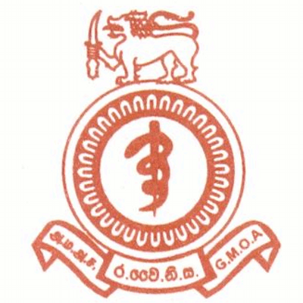
PP 014
EVALUATING A PRE-INTERN TRAINING PROGRAMME ON ESSENTIAL CLINICAL SKILLS
Padeniya P S M A B^{1,2}, Heenatigala C S N^{1,3}, Pieris K V M^{1,3}, Epitakaduwa D C¹, Ranasinghe D¹
¹ Society for Health Research and Innovation (SHRI), ²Lady Ridgeway Hospital, ³Faculty of Medicine, University of Colombo, Sri Lanka
Introduction and objectives
Results
Internship is the bridging stone for medical graduates to become medical professionals. In Sri Lankan there is a delay of nearly one year from completion of the medical degree to the commencement of internship, not the ideal. The aim of this study was to ascertain the effectiveness of a training programme designed to revise the essential clinical skills of pre-intern medical officers in Sri Lanka.
A total of 1089 pre-interns were included in the study. Out of the clinical skills they were trained, there was a significant improvement (p<0.05) on the self-perceived competency in suturing, nasogastric tube insertion, catheterization, monitoring with Glasgow coma scale, cannulation, infusion pump setup, blood and blood products transfusion, removal of intercostal tube, giving injections, lumbar puncture, airway maneuvers, intubation, cardio-pulmonary resuscitation, defibrillation, arterial puncture, wound dressing, suture removal, bandaging, nebulization and connecting to an ECG monitor. There was no significant difference (p>0.05) in self-perceived competency on few procedures including venepuncture, glucometer use, pleural and peritoneal tap.
Method
Significance | Clinical skill
p<0.05 | Suturing, Nasogastric tube insertion, Catheterization, Monitoring with Glasgow coma scale, Cannulation, Infusion pump setup, Blood and blood products transfusion, Removal of intercostal tube, Giving injections, Lumbar puncture, Airway maneuvers, Intubation, Cardio-pulmonary resuscitation, Defibrillation, Arterial puncture, Wound dressing, Suture removal, Bandaging, Nebulization Connecting to an ECG monitor.
p>0.05 | Venepuncture, Glucometer use, Pleural tap, Peritoneal tap
Conclusion
A descriptive study was done among pre-intern medical officers in Sri Lanka in collaboration with a 5 day clinical skills training programme in October, 2014. The data was extracted from a pre and post assessment online data form.
Pre-intern medical officers self-perceived competency on many essential clinical skills improved following a training programme. It is important to promote and sustain pre-intern training programmes in order to improve patient care by junior doctors.
Table: Significance between self-perceived competency in certain clinical skills before and after the training programme

