Slide 1
Good Intern Programme
Workshop -2014
Statistics

Slide 2
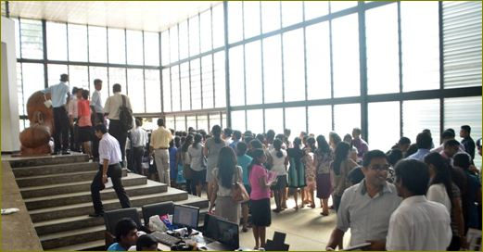
Attendance – 794

Slide 3
Perception of pre interns
Regarding
good intern programme

Slide 4
Overall rating of good intern
programme
94.70%

Slide 5
Pre Interns perception
Is this training worth
your money
YES
86.7%

Slide 6
Would you recommend
this programme ?
YES
98.46%

Slide 7
SATISFACTION OF GIP 2014

Slide 8
Content of the programme – 93.90%
Organization -95.86%
Creating Interest in topic- 95.21%
Pace of delivery of lectures -96.86%
Involvement of participation -92.6%

